Slide 1
Game Development 2B
The Template Pattern

Slide 2

template
The template method works largely with general polymorphism
1
Easiest pattern
2
Template is the idea of a base class giving subclasses access to common methods
3
Having subclasses deal with methods unique to their own implementation
4
Allowing subclasses the override default implementations
5

Slide 3
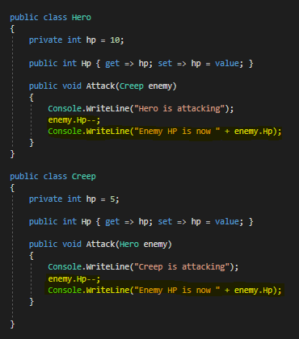
Separate classes and duplication of code

Slide 4
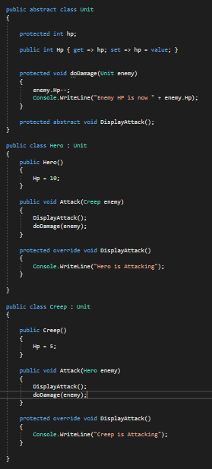
The obvious fix
DoDamage combines the explicitly duplicate code into one generic wrapper function from the base class
Makes it as generic as possible
Any custom implementations, like readouts, need to be overridden in the subclasses

Slide 5
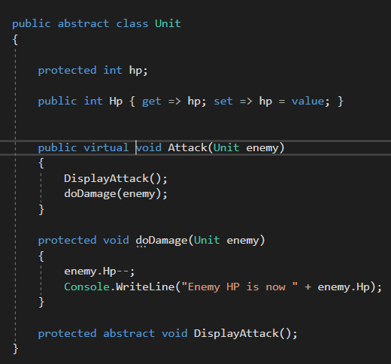
attack
But now attack is exactly the same for both classes
The only difference is our typing
We have a unifying type
We can put this as an implementation in our base class
We can override it later – mark it as virtual
We’re making our code as generic as possible
It still relies on subclass implementations for some steps

Slide 6
Template methods
A template method defines the generic steps of an algorithm across subclasses, but through the use of abstract methods forces subclasses to take responsibility for some of the steps
In this case, how a creep and hero declare their attacks

Slide 7
Genericising classes
Now the base class controls everything major
Maximises reuse
Allows us to create more Units
The Attack() method is a Template Method – it delegates displaying to the subclasses but uses doDamage as a generic method too
The Unit is generic – it codes all generic functionality
Hero and Creep provide specific implementations

Slide 8
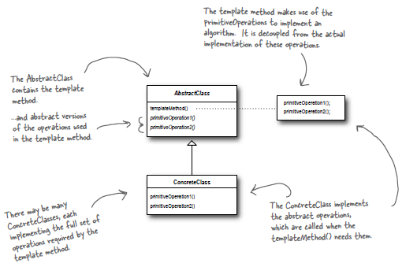
Template method pattern
The Template Method Pattern defines the skeleton of an algorithm in a method, deferring some steps to subclasses. Template Method lets subclasses redefine certain steps of an algorithm without changing the algorithm’s structure.
“Don’t call us, we’ll call you”
The base class deals with all the major functionality
Subclasses only deal with implementation work
We want to work as much as possible with abstractions

Slide 9
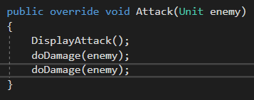
hooks
Hooks are default implementations in a class
Subclasses can override them, if they want to
For example: What if Heros are coded to do two attacks every time they attack
We would need to override attack to attack twice
Creep falls back on Unit’s implementation

Slide 10
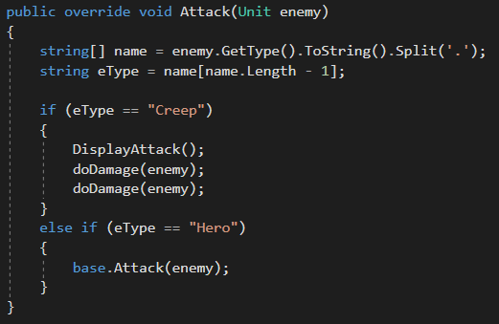
hooks
What if Heroes double attacked creeps, but only single attacked Heroes?
This allows us to create more custom methodology but still fall back on base implementation

Slide 11
The icomparable interface
The IComparable interface uses template method
1
Because it’s an interface, it forces anything that implements it to extend CompareTo
2
Forcing a subclass to do something is part of template method
3
Overriding CompareTo is really useful for custom classes
4
It gives you a “real” way to compare objects based on things like HP, position etc.
5

Slide 12
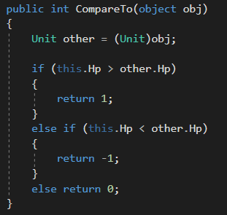
Implementing icomparable

